Slide 1
Week Five– Class One

Slide 2
Static Members of a C++ Class
We can define class members static using static keyword.
When we declare a member of a class as static it means no matter how many objects of the class are created, there is only one copy of the static member.
A static member is shared by all objects of the class.

Slide 3
Static Members of a C++ Class
It can be initialized outside the class using the scope resolution operator :: to identify which class it belongs to.
All static data is initialized to zero when the first object is created, if no other initialization is present.

Slide 4
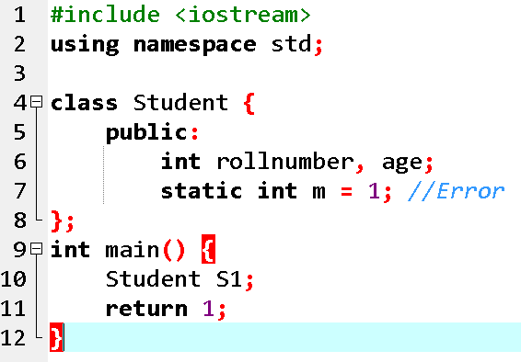
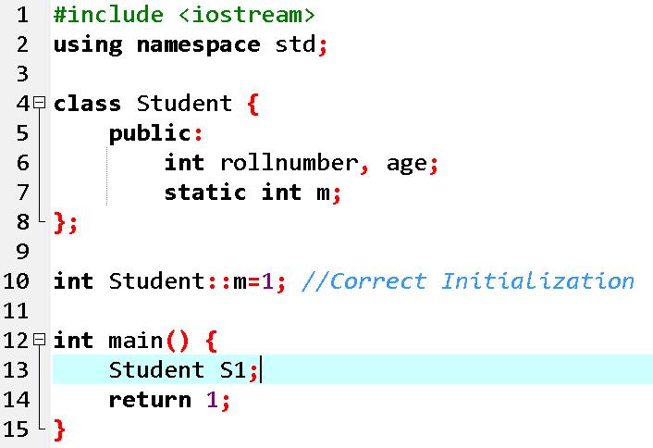
Concept: Static Members can be initialized outside the class

Slide 5
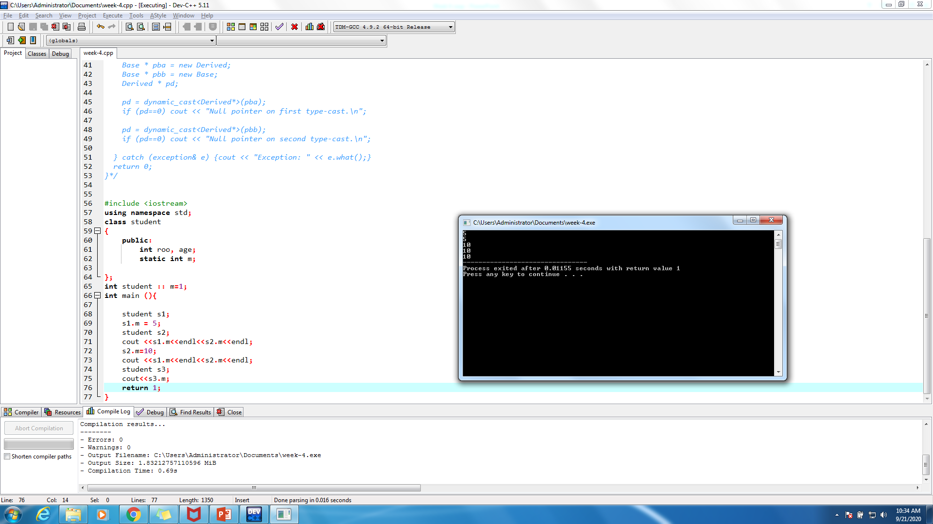
Concept: A static member is shared by all objects of the class

Slide 6
Static Member Functions of a C++ Class
By declaring a function member as static, you make it independent of any particular object of the class
A static member function can be called even if no objects of the class exist and the static functions are accessed using only the class name and the scope resolution operator ::.

Slide 7
Static Member Functions of a C++ Class
A static member function can only access static data member, other static member functions and any other functions from outside the class.

Slide 8
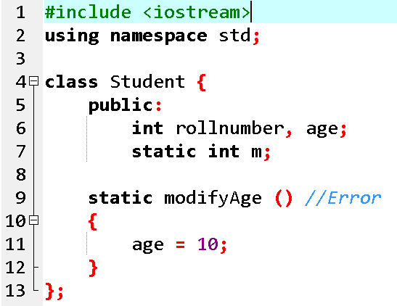
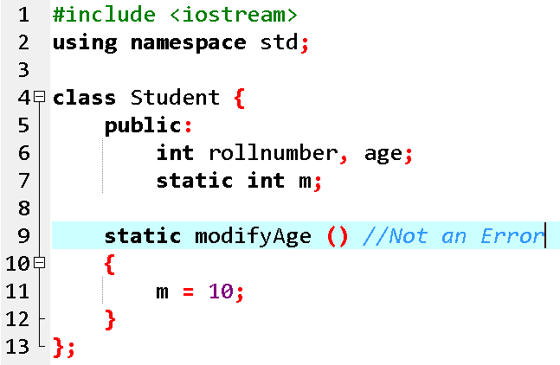
Concept: A static member function can only access static data member

Slide 9
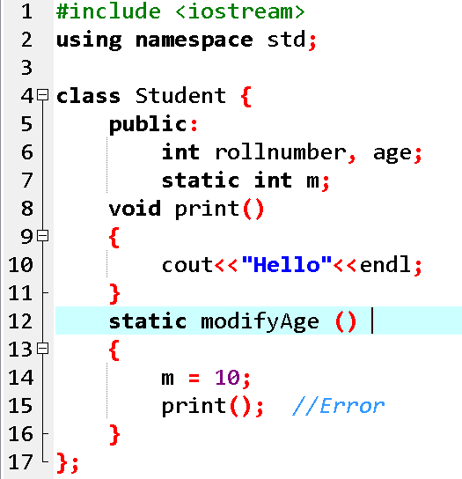
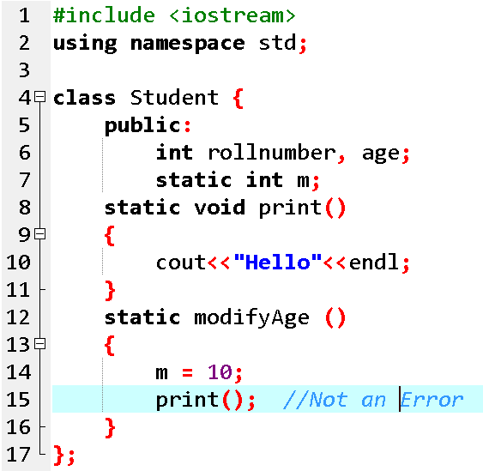
Concept: A static member function can only access other static member functions

Slide 10
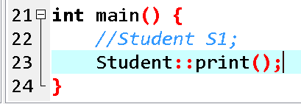
Concept: A static member function can be called even if no objects of the class exist

Slide 11
Inline-Function
The inline functions are a C++ enhancement feature to increase the execution time of a program. Functions can be instructed to compiler to make them inline so that compiler can replace those function definition wherever those are being called.
One of the major objectives of using functions in a program is to save memory space, which becomes appreciable when a function is likely to be called many times.
An inline function is a function that is expanded in line when it is invoked thus saving time.

Slide 12
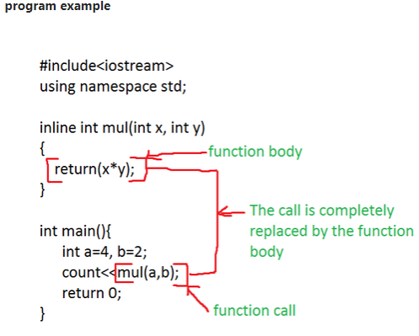
Why we need?
However, every time a function is called, it takes a lot of extra time in executing tasks such as jumping to the calling function.
When a function is small, a substantial percentage of execution time may be spent in such overheads and sometimes maybe the time taken for jumping to the calling function will be greater than the time taken to execute that function.

Slide 13
Inline Function
Remember, inlining is only a request to the compiler, not a command. Compiler can ignore the request for inlining. Compiler may not perform inlining in such circumstances like:
1) If a function contains a loop. (for, while, do-while)
2) If a function is recursive.
3) If a function contains switch or goto statement.

Slide 14
Syntax
For an inline function, declaration and definition must be done together.
inline function-header
{
function-body
}

Slide 15
Inline Function
#include <iostream>
using namespace std;
inline int cube(int s)
{
return s*s*s;
}
int main()
{
cout << "The cube of 3 is: " << cube(3) << "\n";
return 0;
} //Output: The cube of 3 is: 27

Slide 16
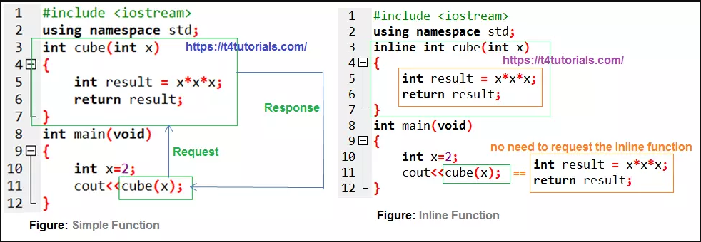
Inline Function

Slide 17
When to use Inline function?
We can use Inline function as per our needs. Some useful recommendation are mentioned below-
We can use the inline function when performance is needed.
We can use the inline function over macros.

Slide 18


Slide 19
Inline functions provide following advantages
Function call overhead doesn’t occur.
It also saves the overhead of push/pop variables on the stack when function is called.
It also saves overhead of a return call from a function.
When you inline a function, you may enable compiler to perform context specific optimization on the body of function. Such optimizations are not possible for normal function calls. Other optimizations can be obtained by considering the flows of calling context and the called context.
Inline function may be useful (if it is small) for embedded systems because inline can yield less code than the function call preamble and return.

Slide 20
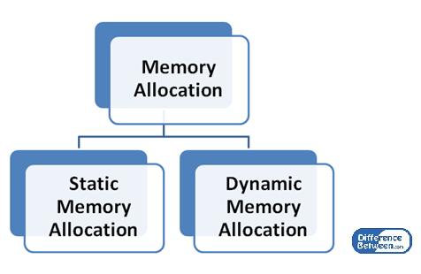
What is Memory Allocation?
There are two ways via which memories can be allocated for storing data.
Compile time allocation or static allocation of memory
Runtime allocation or dynamic allocation of memory

Slide 21
Static Allocation
In static memory allocation, the allocated memory is fixed.
Once the memory is allocated, it cannot be changed.
The memory cannot be increased or decreased.
For example, if the programmer writes int x, which means that the variable can store an integer value. The number of bytes depends on the computer.
There can also be arrays. E.g. int x [5]; This x is an array which can store a sequence of data which are of the same type.
It can store five integer elements. It cannot store more than five elements

Slide 22
Example
void play
{
int a;
}
int main()
{
int b;
int c[10];
return 1;
}

Slide 23
Dynamic allocation
Programmers can dynamically allocate storage space while the program is running, but programmers cannot create new variable names "on the fly", and for this reason, dynamic allocation requires two criteria:
Creating the dynamic space in memory
Storing its address in a pointer (so that space can be accessed)
dynamically allocated space usually placed in a program segment known as the heap or the free store
Exact amount of space or number of items does not have to be known by the compiler in advance.

Slide 24
Dynamic Memory Allocation
C++ defines two unary operators new and delete that perform the task of allocating and deallocating memory during runtime.
Since these operators (new and delete) operate upon free store memory (Heap memory), they are also called free store operator.
Note: If the heap does not have enough memory to allocate, the new request indicates failure by throwing an exception std::bad_alloc, unless “nothrow”.
int *p = new int(25);
int *p = new int[10]

Slide 25
key difference
The key difference between static and dynamic memory allocation is that in static memory allocation once the memory is allocated, the memory size is fixed while in dynamic memory allocation, once the memory is allocated, the memory size can be changed.

Slide 26
Case study
Define a class batsman with the following specifications: Private members: bcode 4 digits code number bname 20 characters innings, notout, runs integer type batavg it is calculated according to the formula – batavg =runs/(innings-notout) calcavg() Function to compute batavg Public members: readdata() Function to accept value from bcode, name, innings, notout and invoke the function calcavg() displaydata() Function to display the data members on the screen.

Slide 27
HAS A Relation
Association:
Explanation: Association represents a relationship between two classes where one class is aware of the other, but they are independent entities. It is a more general form of relationship.
Example: Consider a Teacher class and a Student class. They are associated because a teacher interacts with students, but neither owns the other. Both can exist independently.

Slide 28
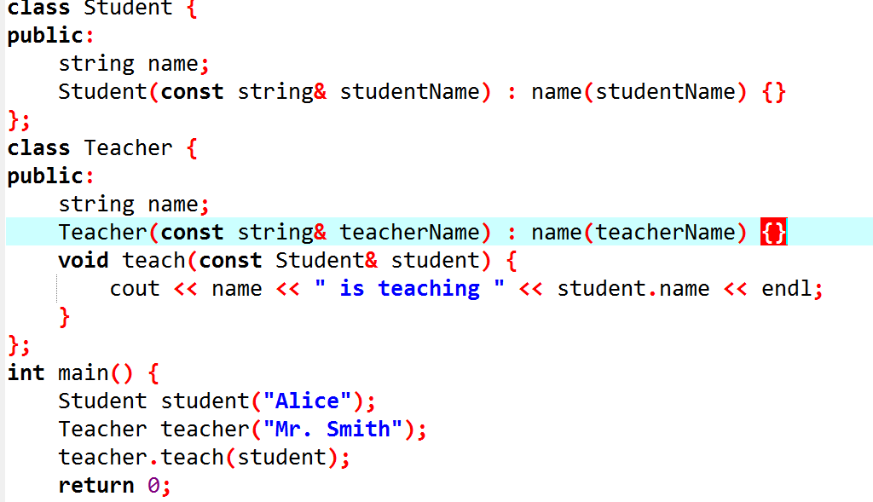
HAS-A Relationships

Slide 29
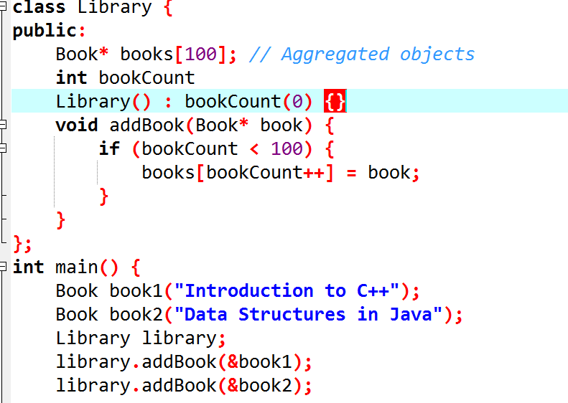
HAS-A Relationships
Aggregation:
Explanation: Aggregation represents a "has-a" relationship where one class is a part of another class, but it can exist independently. It implies a weaker relationship compared to composition, and the part can be shared among multiple owners
.
Example: Consider a Library class and a Book class. Books are part of the library, but they can exist independently of the library, and multiple libraries can have the same book.

Slide 30
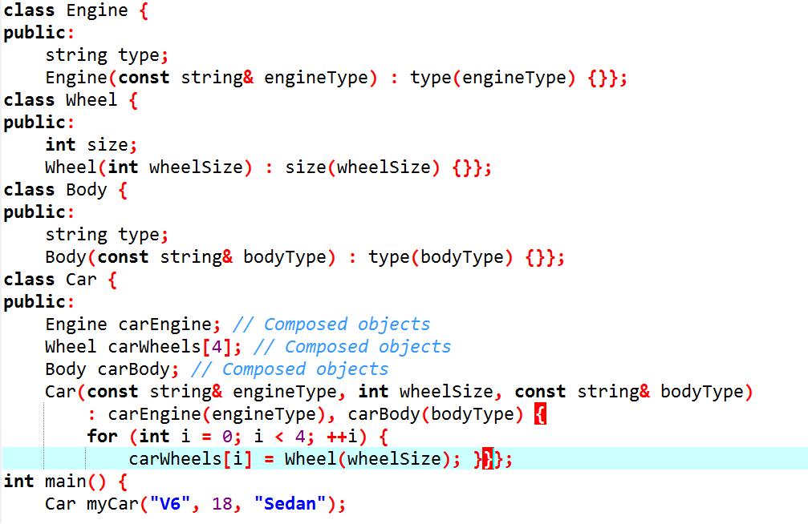
HAS-A Relationships
Composition:
Explanation: Composition represents a strong "owns-a" relationship where one class is a part of another class, and the lifetime of the part is controlled by the whole. If the whole is destroyed, all its parts are also destroyed.
Example: Consider a Car class composed of Engine, Wheel, and Body classes. If the car is destroyed, its components (engine, wheels, and body) are also destroyed.

